Slide 1
Wealth & Water
Tim Altemus, Michael Austin, Han Bui

Slide 2

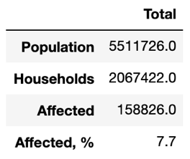
Hurricane Harvey
2 million+ households surveyed in our dataset
~160K households affected
7.7% of population affected
Each row was unique
No outliers / zero row values

Slide 3
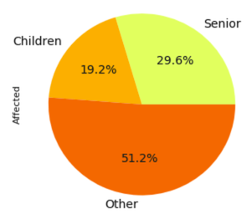
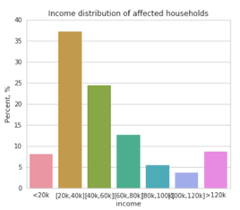
Factors Contributing to Devastation
Affected Percentage?
Age?
Children, Adults, Seniors
Race?
Median Household Income?
Ultimately, decided on MHI

Slide 4
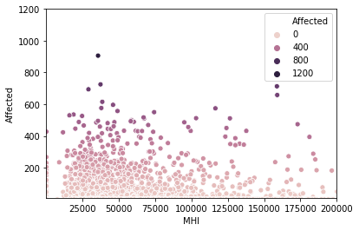
Income & Devastation
Lower income populations more severely affected than higher income populations
Negative correlation coefficient between MHI and Affected Percentage
As income increases, populations less likely to be affected by hurricanes

Slide 5
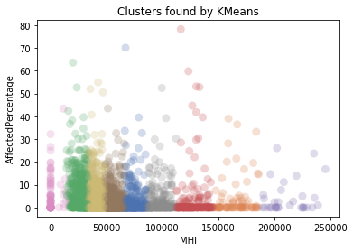
Income & Devastation
KMeans Clustering w/ 9 clusters
3 Lowest Income Clusters:
Avg MHI: $1,173
4.53% Affected
Avg MHI: $26,213
6.15% Affected
Avg MHI: $40,753
4.62% Affected

Slide 6
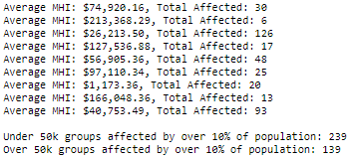
Income & Devastation
Financially comfortable blocks less likely to be affected than lower income blocks
Populations w/ MHI <$50k affected 2 times as much as populations w/ MHI >$50k
Ample access to quality drainage systems

Slide 7
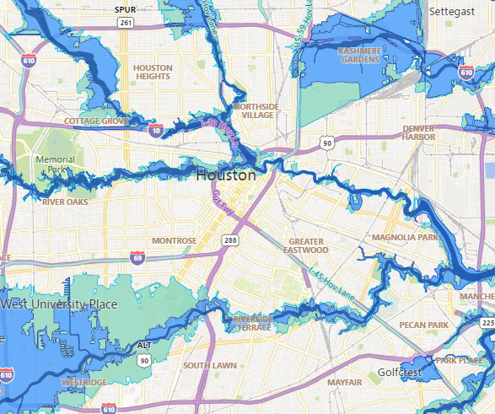
Inside the Loop
MHI is $61, 708
Drainage via Buffalo Bayou, Brays Bayou, and San Jacinto

Slide 8
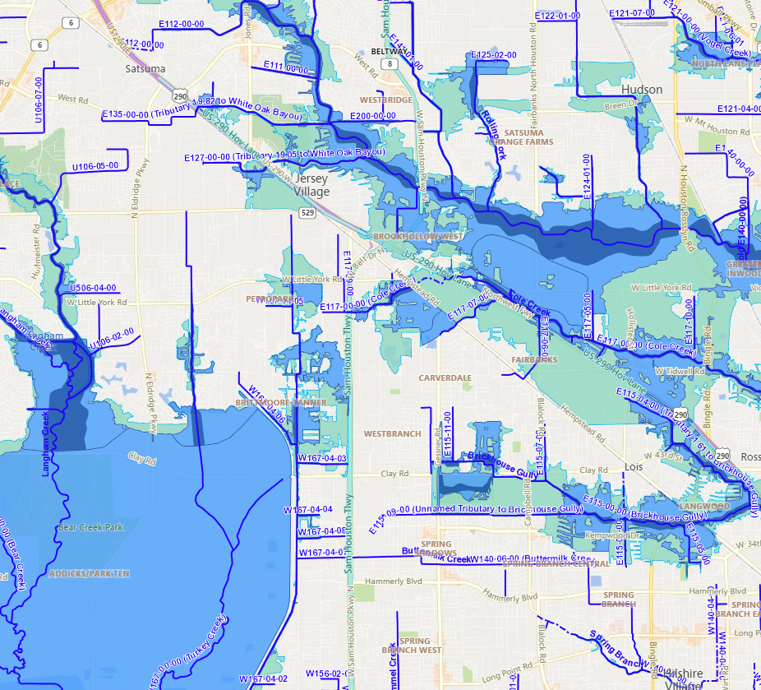
West Houston
MHI < $50,000
Less access to drainage

Slide 9
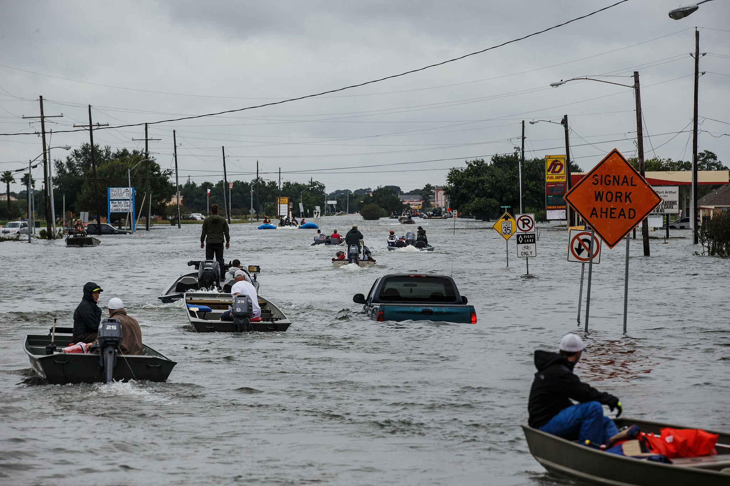
Reparation Funds
Houston received $4.17 billion in funding
Still 100s of thousands devastated Houstonians received zero funding
Additional $2 billion needed for repair

Slide 10
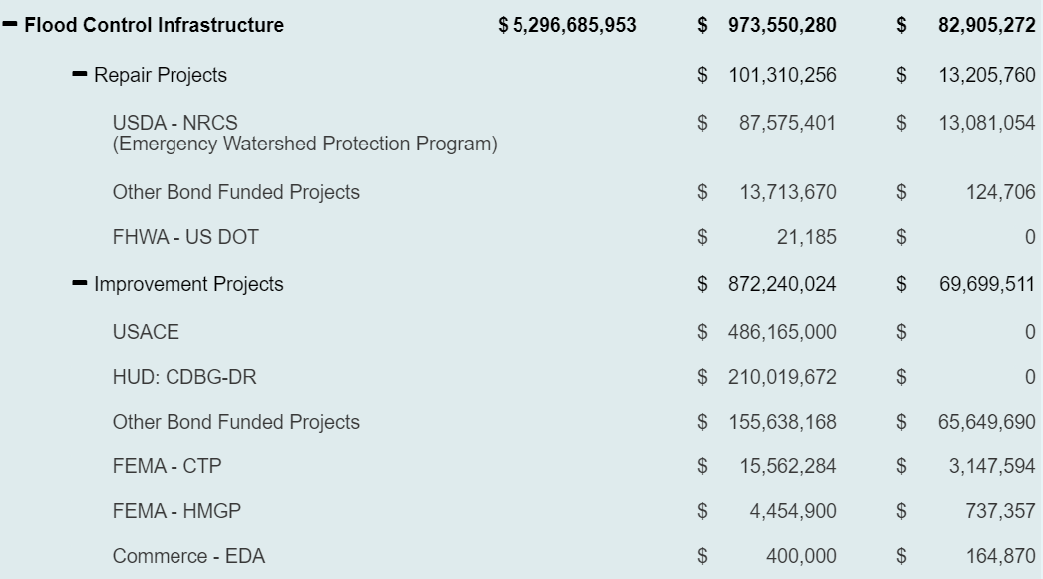
What We Recommend
Support policy
http://www.hcfcd.org/
Check if you and your family are in a risky floodplain
Continue to educate yourself on these issues

Slide 11
Citations
“Impact of Hurricane Harvey on the City of Houston.” Kaggle, Kaggle, 18 June 2018, www.kaggle.com/evgeniya1/impact-of-hurricane-harvey-on-the-city-of-houston.
“Harris County Flood Education Mapping Tool.” Harris County Flood Education Mapping Tool, www.harriscountyfemt.org/.
http://www.hcfcd.org/

